Slide 1
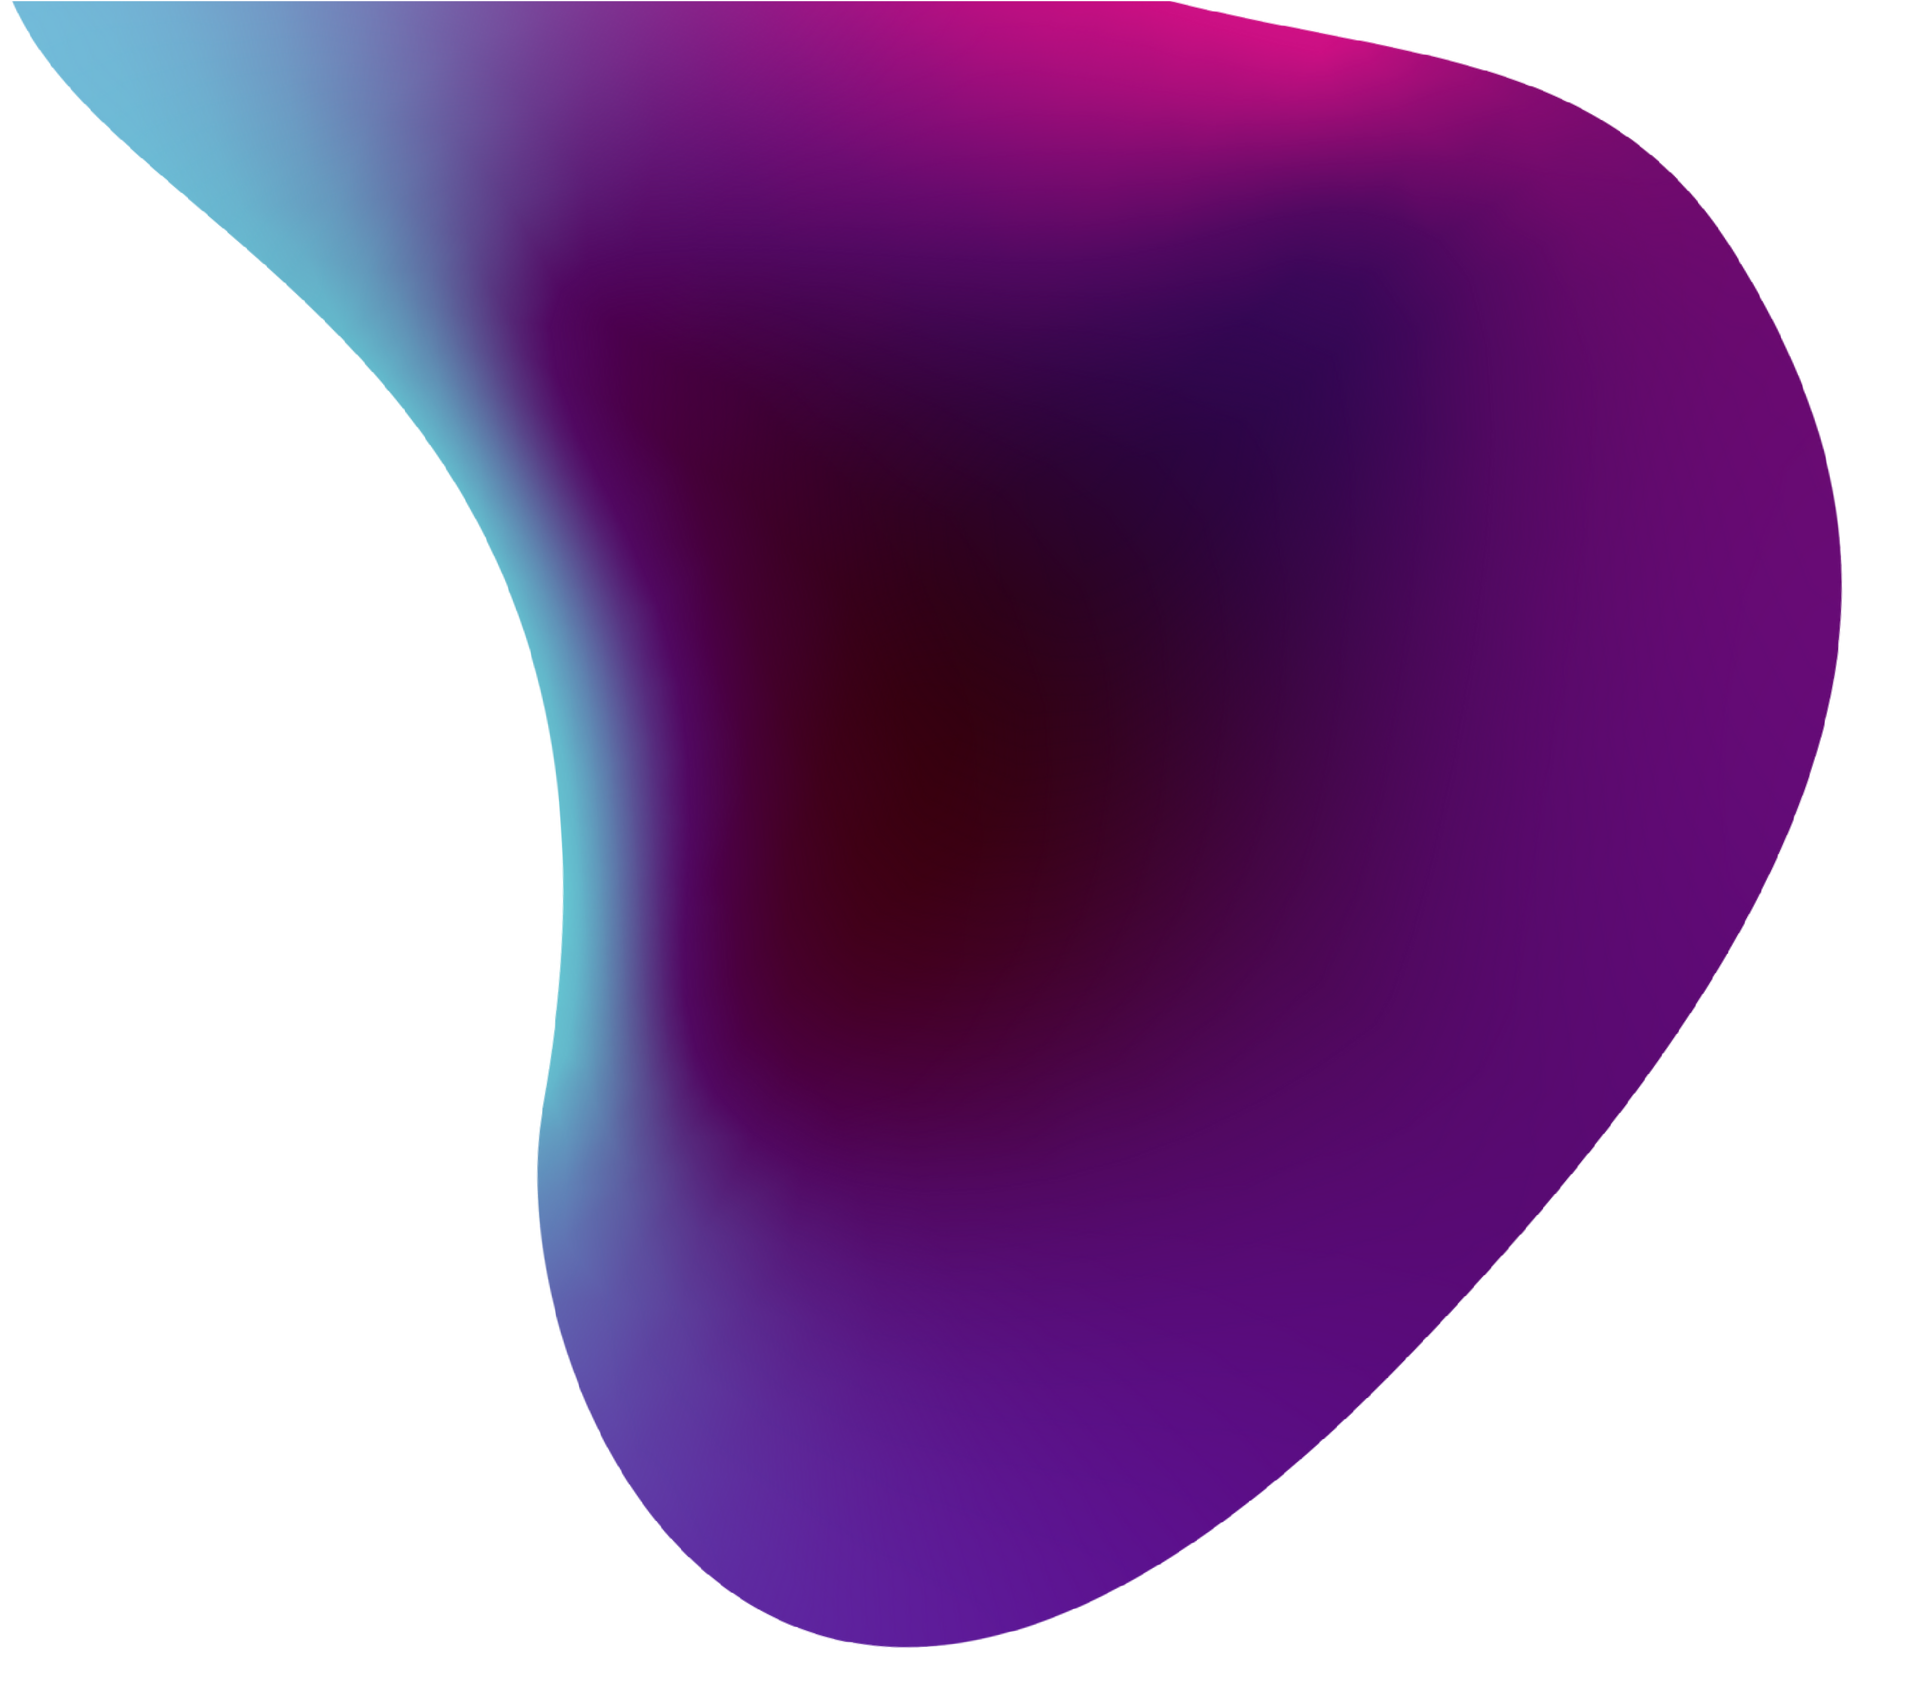
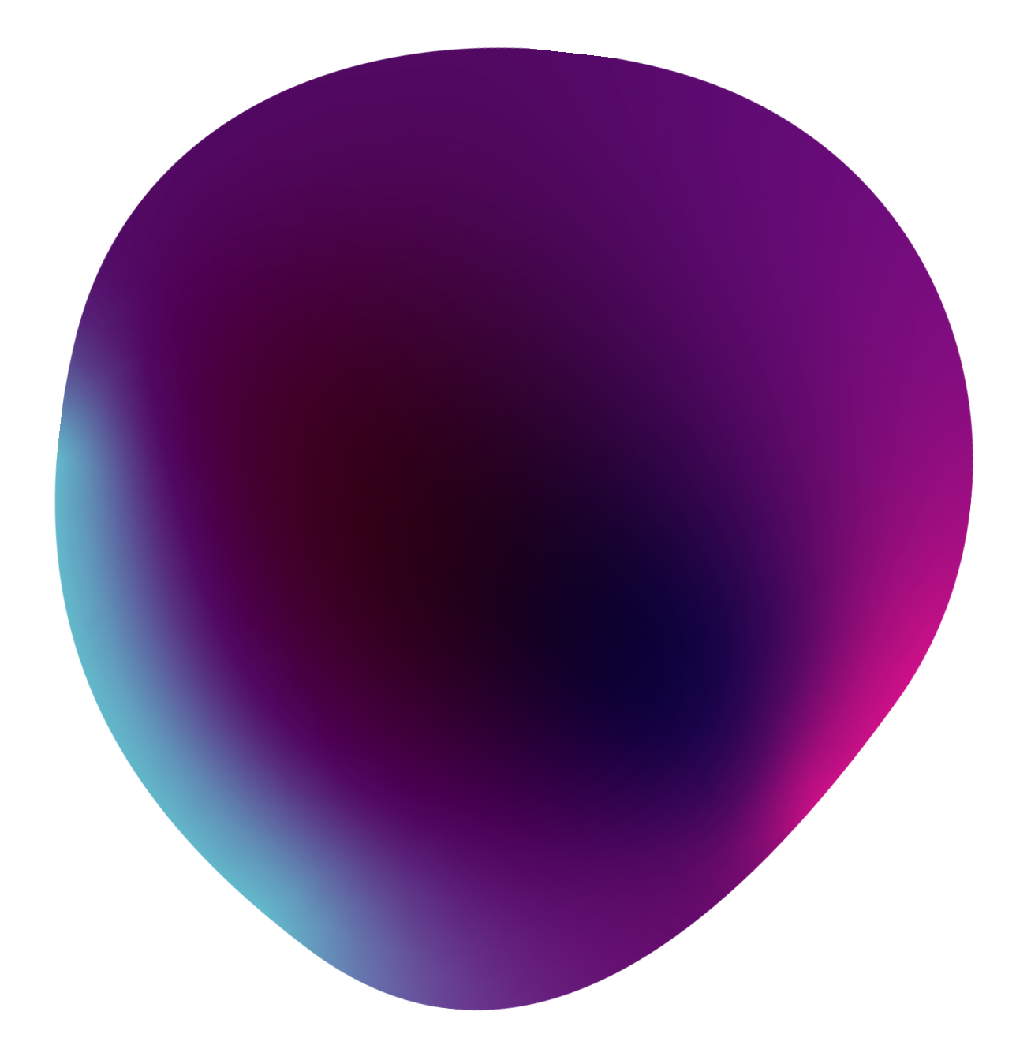

HackZon 2022 Dart Vaders
Team Members: SAIFUDEEN HISHAM K M JUMAINAH KHAN

Slide 2


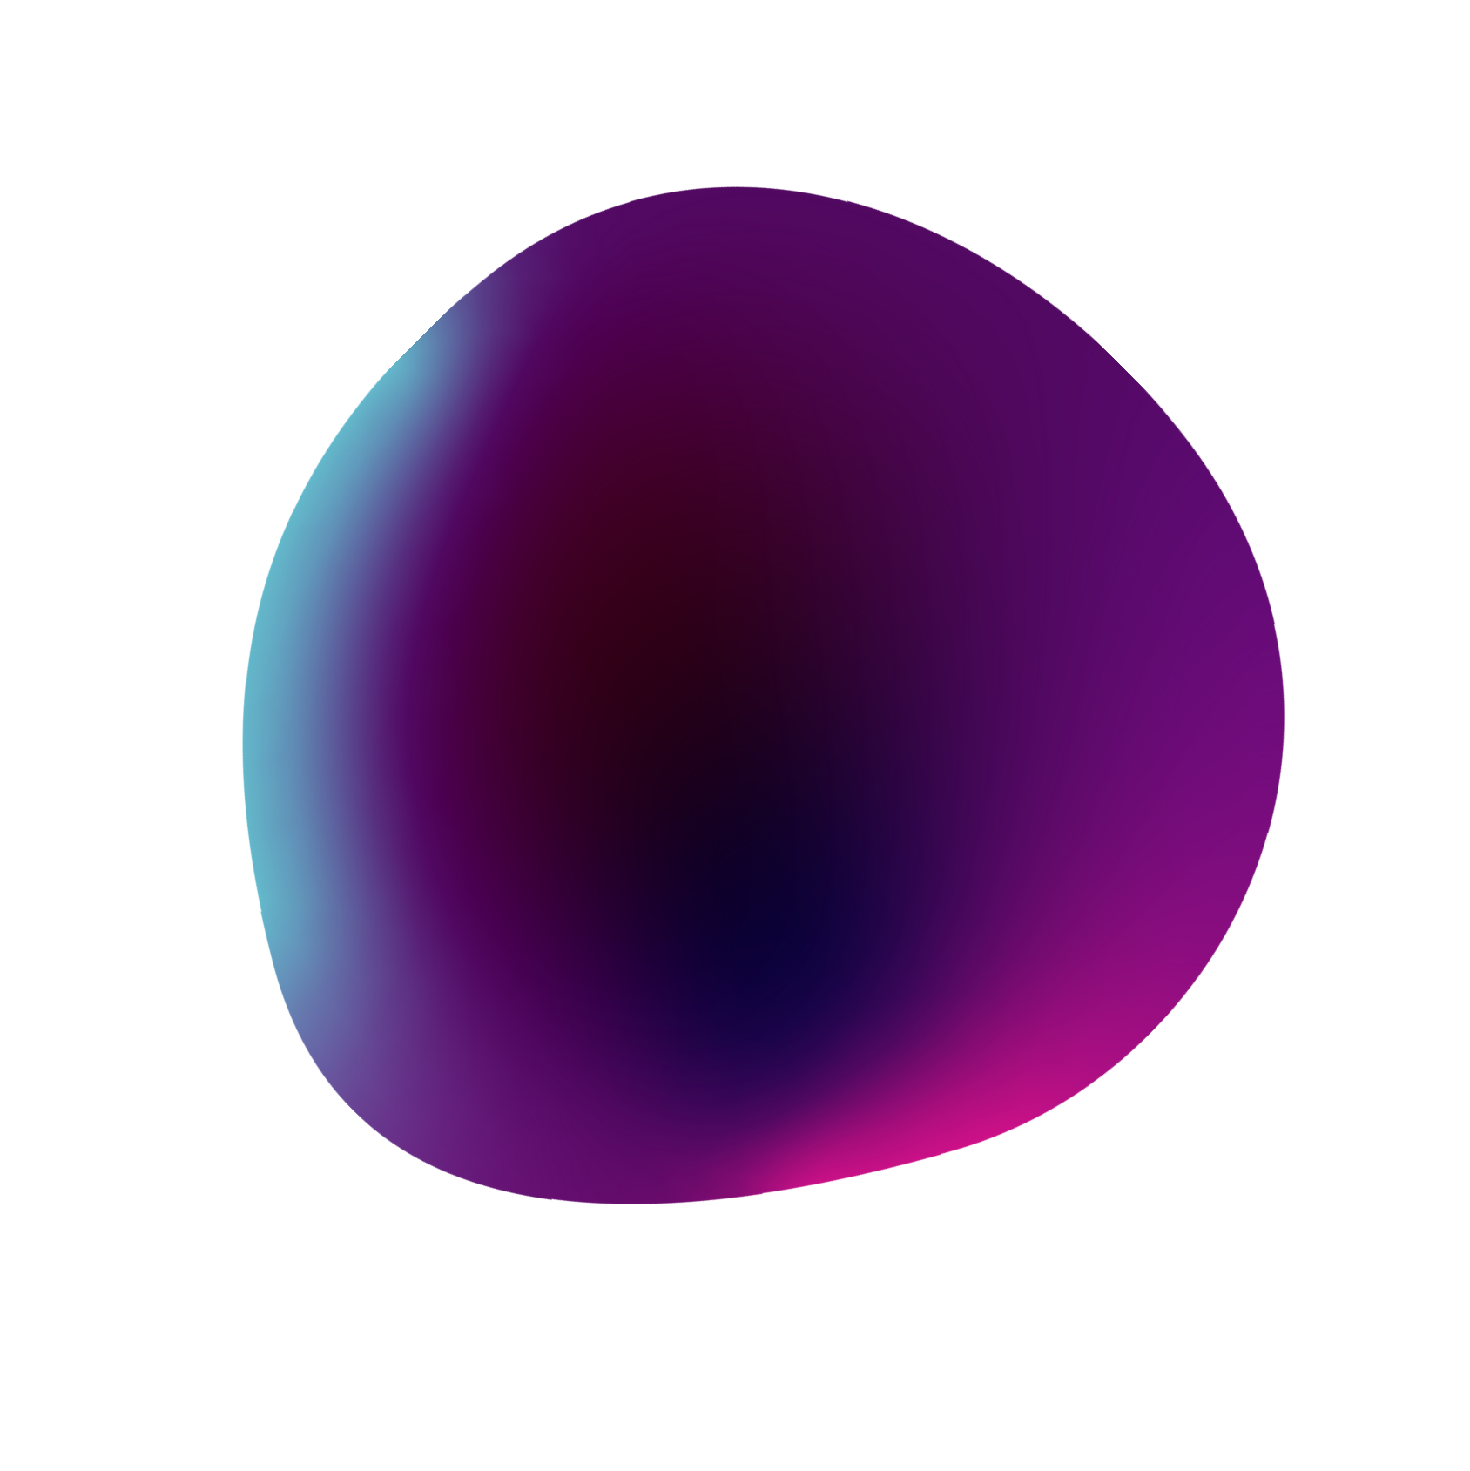
Project Objective: Track Mental Health through photos.
Mental Health tracking over a period of time can be tracked by tracking moods of an individual. The app is named as Ment-AI.

Slide 3
The app will schedule a randomised manner of notifications at different time of day each day. User has to take a picture and our trained AI model will recognise user's mood and add it to their history.
This data will then be used to calculate the statistics of user's mental health over a span of time.
Solution

Slide 4

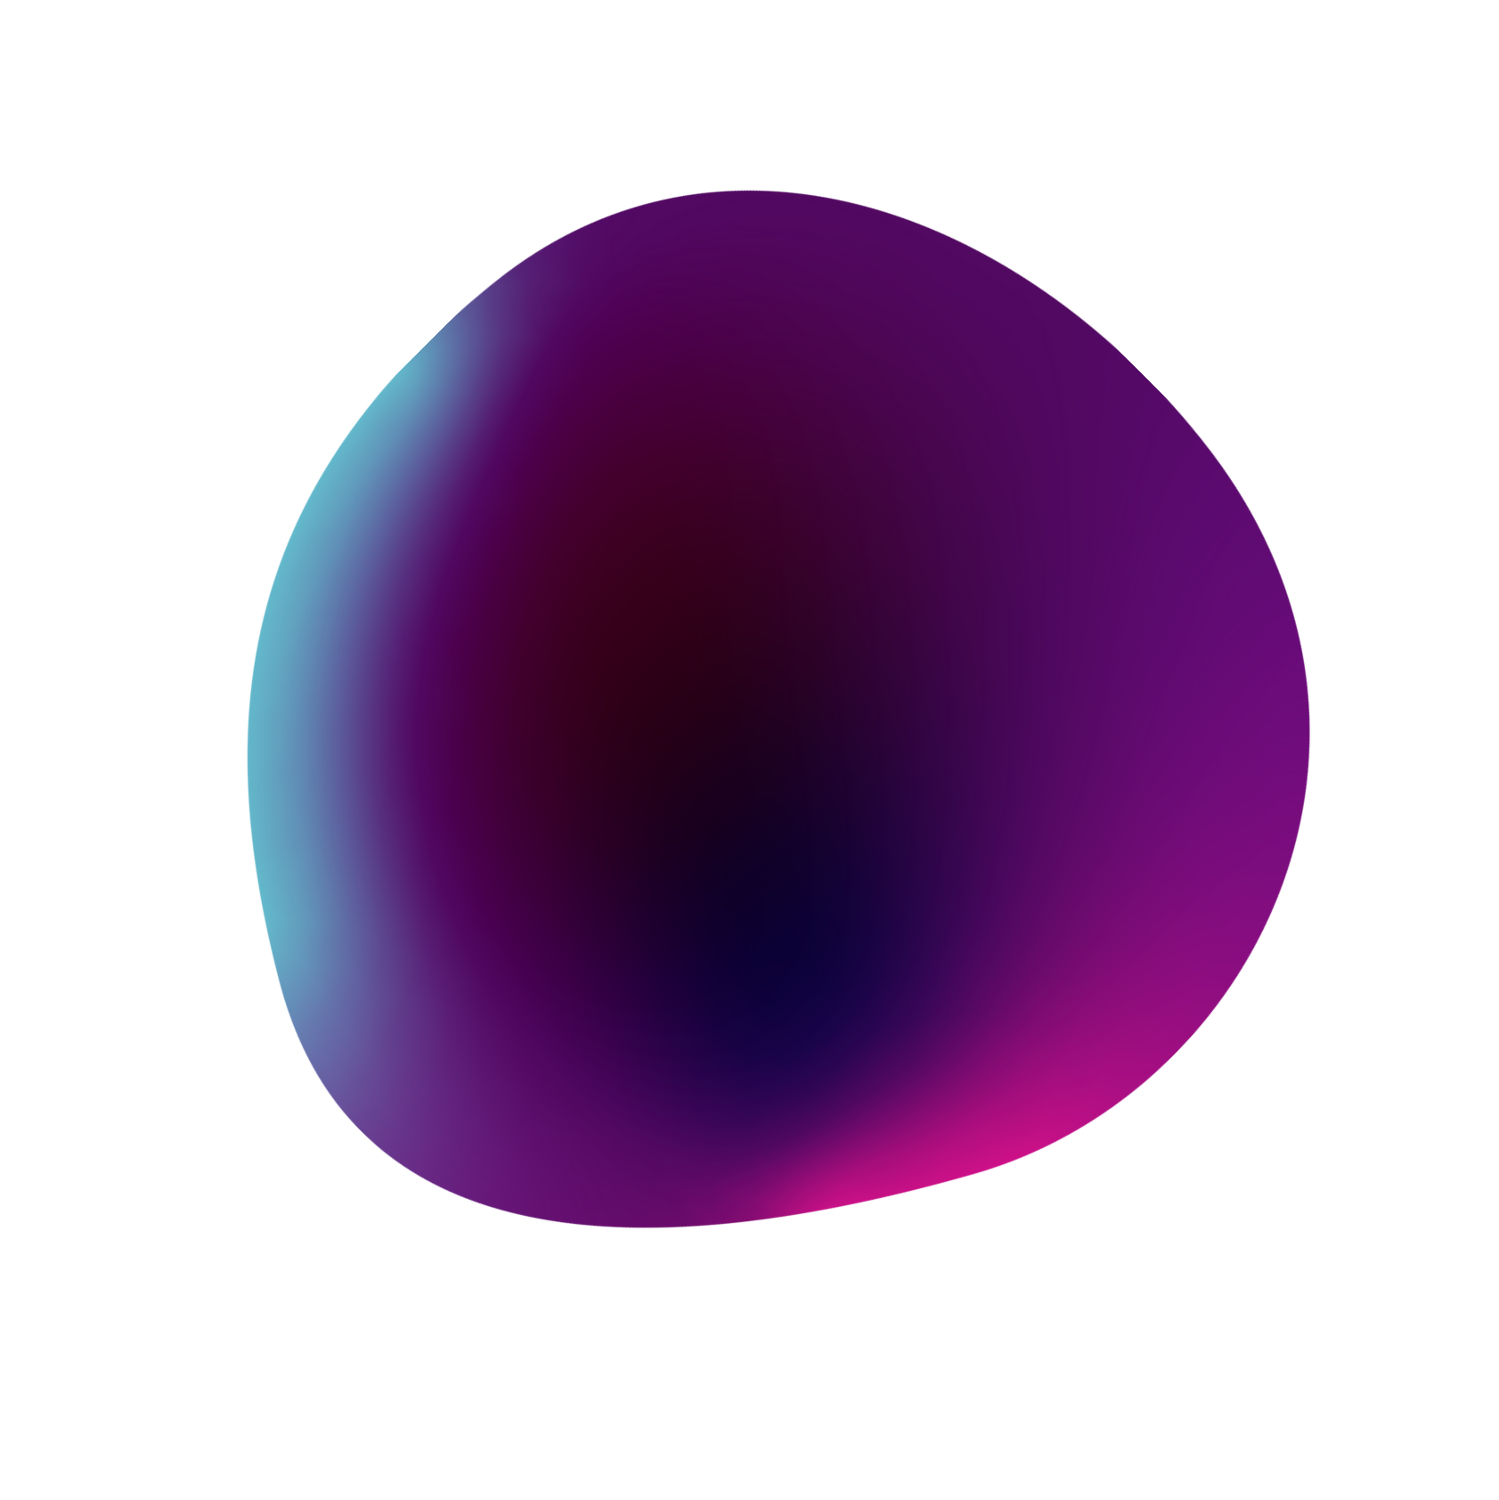

Implementation of Idea
The idea of tracking user's mental health through photos has been implemented through an app, by using the cross
platform framework by Google known as Flutter. The AI Model has been added through the help of TensorFlow.

Slide 5

Functionality of the Project
Flutter and Dart
Flutter is an Open-Source UI SDK developed by Google. It allows the development of iOS/Android apps and uses Dart as the programming language. Dart is an Open-Source, client-side programming language. It is easy to learn, stable, and creates high-performance applications.
GetX
GetX is an extra-light and powerful solution for Flutter. It combines high-performance state management, intelligent dependency injection, and route management quickly and practically.
.
TensorFlow
TensorFlow is a free and open- source software library for machine learning and artificial intelligence. It can be used across a range of tasks but has a particular focus on training and inference of deep neural networks.

Slide 6
Scalability
Minimum Viable Product: Use Firebase service to manage users in the beginning, if users increase create our own database management server by using ServerPod and Docker services that go hand in hand with flutter.
New features like pairing up with a partner can be added to monitor your spouse, child, or friend's mental health and also be able to guide them when they're in need.

Slide 7
Thank You
-Dart Vaders

